Slide 1
WISE Programme

Slide 2
a state of overall mental and physical health, strength, resilience and fitness to function well personally and at work
the foundation of academic and professional success
Wellbeing
WISE
Programme
To promote healthy living and improve wellbeing so that law students will lead a physically and mentally healthy life as a student and all the way through their future career, and a healthy and supportive community for law students can be built at HKU.

Slide 3
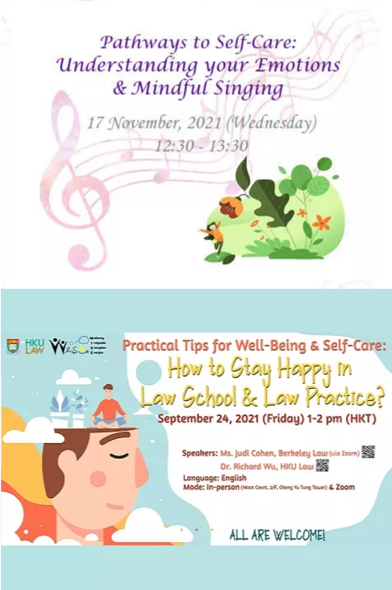
Past WISE Events
Talks & Sharing

Slide 4
Past WISE Events
Workshops

Slide 5
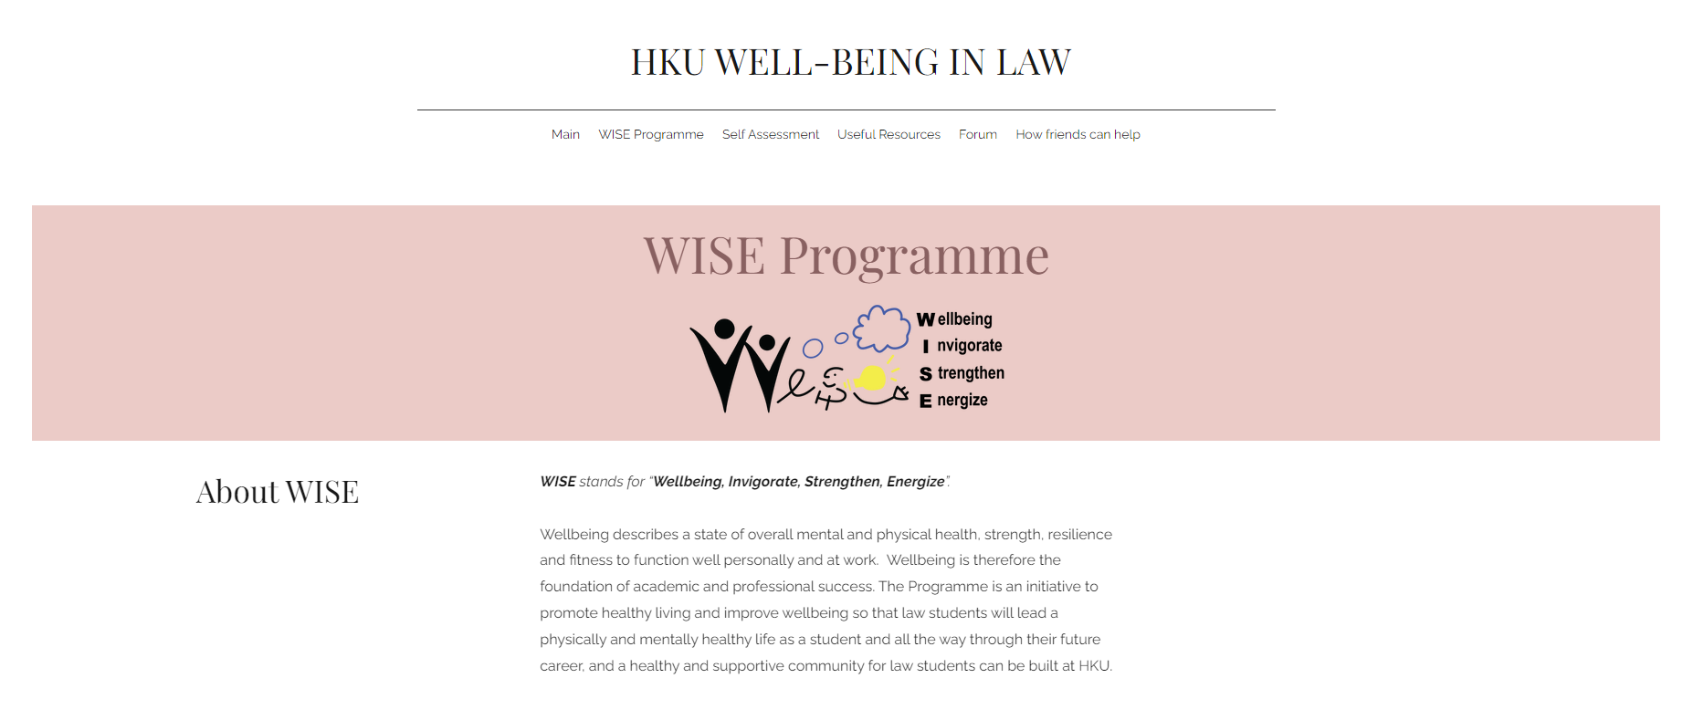
For more details and updates, please visit: https://www.wellbeinginlaw.hku.hk/

